Slide 1

EXAMINING THE EFFECT OF REMOTE WORKING ON MENTAL HEALTH

Slide 2
GROUP 8
PETROLINA HENRY-OKERE
EBENEZER QUARSHIE
MAYOWA ONI
UCHENNA UWAGBALE
MILAN MANOJ

Slide 3
INTRODUCTION
Mental health has emerged as a critical issue in the era of remote work. The flexibility offered by remote work often comes with challenges such as isolation, blurred work-life boundaries, and limited access to support systems. This study investigates the use of machine learning models to predict mental health conditions among remote employees based on features including work-life balance, job satisfaction, stress level, and company support.

Slide 4

PROBLEM STATEMENT
How does remote work impact employees' mental health?
What are the key stressors and benefits associated with remote work?
What work policies can improve mental health outcomes in remote work settings?
Notes:
1. How does remote work impact employees' mental health?
Remote work has both positive and negative effects on mental health.
Some employees benefit from flexibility and autonomy, while others experience stress, isolation, or burnout.
This study aims to measure the extent of these effects using survey data.
2. What are the key stressors and benefits associated with remote work?
Key Stressors: Work-life balance challenges, Social isolation, Longer working hours or increased workload.
3. What work policies can improve mental health outcomes in remote work settings?
Identifying effective workplace policies is crucial for enhancing employee well-being.
Possible solutions include: Mental health support programs such as counseling, workshops)., Flexible work arrangements such as hybrid models, adjustable hours, Clear boundaries between work and personal life for example , no emails after work hours).

Slide 5

METHODOLOGY
Primary data using survey responses.
Descriptive statistics for trends in mental health and satisfaction.
Extract insights on the impact of remote work on mental health through Identifying patterns and provide actionable recommendations to address mental health challenges.
Models: RandomForest, Logistic regression, SVM, XGBoost, Neural Network
Notes:
1. Data Collection (Primary Data - Survey Responses): The dataset was collected through survey responses from employees working remotely with survey included questions on stress levels, work hours, job satisfaction, and access to mental health resources.
2. Data Analysis Techniques: Descriptive Statistics Used to summarize trends in mental health and job satisfaction. And also helps in understanding average stress levels, working hours, and satisfaction scores.
3. Correlation Analysis: Identifies relationships between key variables such as: Stress levels vs. Work hours – Do longer hours contribute to higher stress? Access to mental health resources vs. Job satisfaction – Do employees with better resources report lower stress?
4. Machine Learning Models Used: Random Forest – Used for feature importance analysis and classification. Logistic Regression – Applied for predicting mental health conditions. SVM (Support Vector Machine) – Helps find the best boundary between employees experiencing mental health challenges and those who don’t. XGBoost – A powerful gradient boosting model used for improved accuracy. Neural Networks: because of its ability to capture complex, non-linear relationships within the dataset.
5. Goal of the Analysis: Extract actionable insights from the data. Identify key patterns affecting remote workers’ mental health. Provide data-driven recommendations to improve workplace policies and well-being initiatives.

Slide 6
MODEL PERFORMANCE INSIGHTS
 | True (1) | True (0) | Class Precision
Prediction (1) | ~870 | ~230 | 0.76 (Class 1)
Prediction (0) | ~218 | ~866 | 0.79 (Class 0)
Class Recall | 0.8 | 0.76
Logistic Regression: It is used for binary classification making it suitable for predicting mental health condition which is either present = 1 or absent = 0.
It is relatively balanced and catches 80% of at-risk individuals (high recall) and is reasonably accurate in predicting both classes.
Best suited when interpretability is important and balanced sensitivity and specificity are acceptable.

Slide 7
MODEL PERFORMANCE INSIGHTS CONTD.
 | True (1) | True (0) | Class Precision
Prediction (1) | ~979 | ~110 | 0.83 (Class 1)
Prediction (0) | ~109 | ~986 | 0.90 (Class 0)
Class Recall | 0.9 | 0.82
Random Forest: Demonstrates the best performance for mental health risk detection.
Accuracy: 86.22% (best overall)
90% recall for at-risk individuals = excellent at identifying those in need.
Also has the highest precision for Class 0, meaning few false alarms when it says someone is not at risk.
Recommended if you want high reliability and strong predictive power.

Slide 8
MODEL PERFORMANCE INSIGHTS CONTD.
 | True (1) | True (0) | Class Precision
Prediction (1) | ~925 | ~187 | 0.83 (Class 1)
Prediction (0) | ~163 | ~909 | 0.85 (Class 0)
Class Recall | 0.85 | 0.83
XGBoost finds the best decision boundary to separate 2 classes. The SVC(kernel=‘rbf’, random_state=42) creates a SVM classifier with an RBF kernel commonly used for non-linear classification problems.
Very strong performer, nearly matching Random Forest.
Excellent recall (85%) and precision (83%) for predicting at-risk individuals.
Great for applications where you need both accuracy and generalization, especially on slightly noisy data.

Slide 9
MODEL PERFORMANCE INSIGHTS CONTD.
 | True (1) | True (0) | Class Precision
Prediction (1) | ~936 | ~164 | 0.77 (Class 1)
Prediction (0) | ~152 | ~822 | 0.85 (Class 0)
Class Recall | 0.86 | 0.75
Support Vector Machine (SVM): SVM finds the best decision boundary to separate 2 classes. The SVC(kernel=‘rbf’, random_state=42) creates a SVM classifier with an RBF kernel commonly used for non-linear classification problems.
SVM is also quite strong, especially in catching at-risk individuals (86% recall).
Slightly lower precision for Class 1, so more false positives than XGBoost or RF.
Best used when maximizing detection of at-risk individuals is the priority, and slight overflagging is acceptable.

Slide 10
MODEL PERFORMANCE INSIGHTS CONTD.
 | True (1) | True (0) | Class Precision
Prediction (1) | ~936 | ~175 | 0.78 (Class 1)
Prediction (0) | ~152 | ~833 | 0.84 (Class 0)
Class Recall | 0.86 | 0.76
The neural network model was deployed because of its ability to capture complex, non-linear relationships within the dataset.
Similar to SVM, Neural Networks achieved high recall (86%), meaning they’re great at detecting mental health risk.
Slightly lower Class 1 precision than XGBoost/Random Forest.
Powerful when used in automated screening, where early detection is more important than false positives.

Slide 11
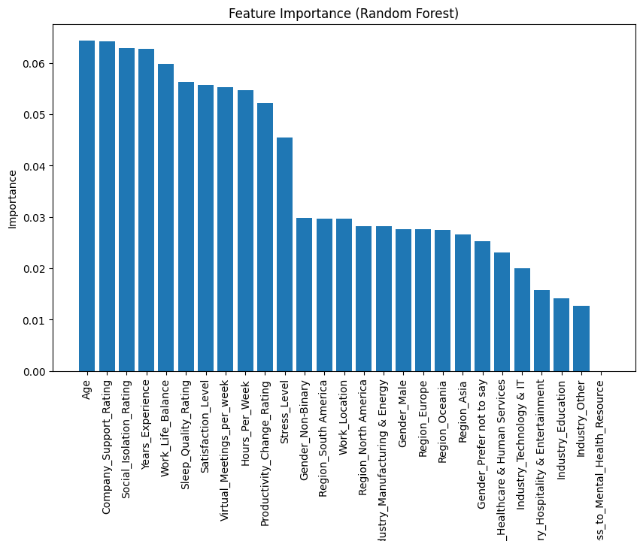
FEATURE IMPORTANCE
Notes:
This chart illustrates the most influential features used by the model (e.g., Random Forest) to predict mental health conditions.
At the top, we see features like: Age, Company Support for Remote Work, Social Isolation Rating, Years of Experience, Work-Life Balance, Sleep Quality, Satisfaction with working conditions, No. of virtual meetings per week, Hours worked per week & Stress level. These had the highest importance scores, meaning they had the greatest impact on the model's predictions.
Age, Stress Level being amongst the top feature indicates how directly it correlates with mental health issues, and this definitely aligns with real-world expectations.
Work-Life Balance and Company Support highlight the role of organizational support and lifestyle balance in mental well-being.
Features like Sleep Quality and Social Isolation show how physical and emotional experiences affect mental health outcomes.

Slide 12
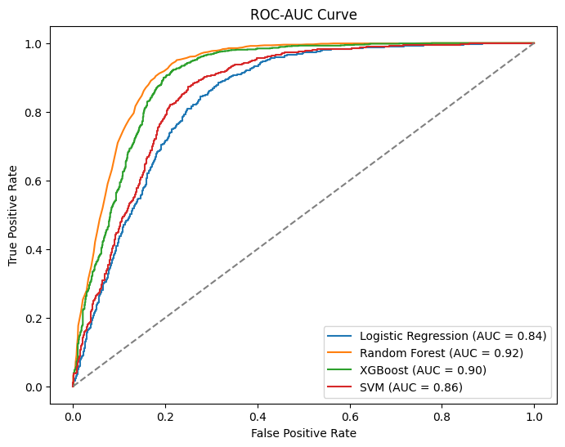
ROC-AUC CURVE
Notes:
The ROC (Receiver Operating Characteristic) curve Is a graphical representation of a model's ability to distinguish between classes—in this case, predicting whether a person is at risk of mental health issues or not.
The AUC (Area Under the Curve) quantifies this performance. AUC values range from 0.5 (no better than random guessing) to 1.0 (perfect prediction). The higher the AUC, the better the model is at correctly classifying positive and negative outcomes.
All the models show AUC above 80% meaning they all excelled - the closer the curve hugs the top-left corner, the better the model. Random Forest and XGBoost had curves closest to that corner, confirming their high AUC scores.

Slide 13
DEMO

Slide 14

FIXED ISSUES FROM VERSION 1
Improve Class Balance
Apply SMOTE or other relevant techniques (Hybrid Oversampling & Undersampling) to improve model performance.
Experiment with class weighting in models to reduce bias.
Hyperparameter Tuning
Optimize XGBoost & Random Forest with GridSearchCV.
Adjust SVM kernel & regularization for better performance.
Try Different Models
Test Gradient Boosting Machines (GBM), CatBoost, or Neural Networks.
Compare performance using Precision-Recall AUC instead of Accuracy.

Slide 15
RECOMMENDATIONS
Incorporate time-series analysis to monitor mental health over longer periods.
Extend the data collection to include on-site workers for comparative studies.
Improve model interpretability using SHAP or LIME explanations.
Integrate predictive tools into HR systems to provide early warnings and personalized support.

Slide 16
THANK YOU

